Slide 2
Cisco Expressway at the Collaboration Edge
Design Session
BRKUCC-2801
Kevin Roarty
Technical Marketing Engineer
Cisco Collaboration

Slide 3
Abstract
Cisco Expressway is an important part of the Collaboration Edge Architecture offering a mobile and remote access alternative to VPN.
The solution allows Jabber clients to securely traverse the enterprise firewall and access collaboration services deployed on the enterprise network.
Remote Jabber clients will have access to voice/video, instant messaging and presence, visual voicemail, and directory look-up services.
This session will include a solution overview including how Jabber clients connect over the edge and register to Unified CM, the evolution of Expressway firewall traversal, options for IM & Presence services, and also how remote TelePresence endpoints can now register to Unified CM through Expressway.
Participants will receive design guidance including deployment options, limitations, best practices, required software versions, and security considerations.

Slide 4
Sessions of Interest
Session Number | Session Name | Speaker | Day
BRKUCC-2344 | Deploying Cisco Jabber on Mobile Devices | Seongho Hong | Tuesday
BRKUCC-2345 | Cisco Jabber: Deploying Cisco Jabber On Premise | Shane Long | Wednesday
BRKUCC-2355 | Cisco Jabber: Deploying Cisco Jabber with WebEx Messenger | Shane Long | Wednesday
BRKUCC-2008 | Enterprise Dial Plan Fundamentals | Johannes Krohn | Wednesday
BRKUCC-2444 | Introduction to Common Identity for Collaboration | Paulo Jorge Correia | Wednesday
BRKCOL-2777 | Emerging Video Technologies: H.265, SVC, and WebRTC | Mo Zanaty | Wednesday
BRKEVT-2803 | Designing and deploying multipoint conferencing for telepresence video | Richard Murphy | Wednesday
BRKUCC-2340 | Best practices to enable rich-media Collaboration between businesses | Viraj Raut | Wednesday
BRKUCC-2226 | Planning and Designing Virtual Unified Communication Solution | Daniel Gerber | Wednesday
BRKUCC-2501 | Cisco UC Manager Security | Kevin Roarty | Wednesday
BRKCOL-2455 | Fixing SIP Problems with Cisco Unified Communications Manager's SIP Normalization Tools | Mark Stover | Thursday
BRKUCC-3000 | Advanced Dial Plan Design for Unified Communications Networks | Johannes Krohn | Thursday
BRKEVT-2802 | Deploying TelePresence and Video Endpoints on Unified Communications Manager | Kevin McMenamy | Thursday
BRKUCC-2800 | Extend the Reach of Your Cisco Video Solution with Cisco Jabber Guest | Darin Dunlap | Thursday
BRKCOL-2114 | What you need to know about Webex Enabled TelePresence | Andrew Bell | Thursday
BRKUCC-2006 | SIP Trunk design and deployment in Enterprise UC networks | Anthony Mulchrone | Friday
BRKUCC-3420 | Advance concepts to Common Identity for Collaboration | Paulo Jorge Correia | Friday
BRKUCC-2943 | Enabling Cisco Jabber for Virtual Environments | Sijin Abdulkarim | Friday

Slide 5
Agenda
Terminology Introduction
Expressway Mobile & Remote Access Solution Overview
Product Line Options, Licensing, Scalability
Design and Deployment Considerations
Expressway Configuration
Unified CM Requirements
Security
Expressway Server Certificates
Closing Remarks
Q & A

Slide 6
Terminology Introduction

Slide 7



Introducing Cisco Collaboration Edge Architecture
Industry’s Most Comprehensive Any-to-Any Collaboration Solution
Mobile
Workers
Teleworkers
All the capabilities of Cisco Any-to-Any collaboration to-date
  TDM & analog gateways
  ISDN Video gateways
  Session border control
  Firewall traversal
  Standards-based & secure
B2B
TDM or
IP PBX
COLLABORATION EDGE ARCHITECTURE
Consumers
PSTN or IP PSTN
3rd Parties
Branch Office
Cloud Services
Analog Devices
Notes:
Expressway is a key piece that helps round out our collaboration edge architecture
The architecture combines the new capabilities of Cisco Expressway with the current core capabilities of Cisco Collaboration and the network to break down barriers and deliver the industry’s most comprehensive any to any solution on the market.
The Cisco Collaboration Edge Architecture is not just about voice or any other single collaboration workload (video, IM, etc.) but includes all relevant collaboration workloads and the associated content.
This diagram shows the use cases the architecture enables such as B2B, B2C, PSTN connectivity, 3rd party integrations and more. We have been delivering many of these capabilities for years – such as IP PSTN and PSTN connectivity through our TDM Gateway and session border controller products and, features on CUCM like Extend and Connect, to connect these islands and level the playing field to better enable collaboration. But now, we have simplified mobile, tele-worker and b2c collaboration.
The benefits of the architecture are:
Simple. For example, video calls should be as easy as a voice call. Pick your collaboration tool and connect. That’s it.
Usable. Usability is critical for any to any collaboration and this architecture brings all these capabilities together to provide richer and more productive interactions that are easy to use.
Secure deployments – IT must have an architecture that is easy to deploy and secure. Examples include the ability to register remote, mobile and 3rd party endpoints to Cisco Unified CM, and to securely initiate and encrypt collaboration sessions.
By implementing this type of architecture, you are making any to any collaboration easier to deploy and providing richer experiences that are easier to use.

Slide 8
Cisco Expressway
A new gateway solving & simplifying business relevant use cases
Mobile
Workers
Teleworkers
For Unified CM & Business Edition environments
Based on Cisco VCS Technology
Standards-based interoperability
B2B
TDM or
IP PBX
COLLABORATION EDGE ARCHITECTURE
Consumers
PSTN or IP PSTN
3rd Parties
Branch Office
Cloud Services
Analog Devices
Notes:
Expressway is a key piece that helps round out our collaboration edge architecture
The architecture combines the new capabilities of Cisco Expressway with the current core capabilities of Cisco Collaboration and the network to break down barriers and deliver the industry’s most comprehensive any to any solution on the market.
The Cisco Collaboration Edge Architecture is not just about voice or any other single collaboration workload (video, IM, etc.) but includes all relevant collaboration workloads and the associated content.
This diagram shows the use cases the architecture enables such as B2B, B2C, PSTN connectivity, 3rd party integrations and more. We have been delivering many of these capabilities for years – such as IP PSTN and PSTN connectivity through our TDM Gateway and session border controller products and, features on CUCM like Extend and Connect, to connect these islands and level the playing field to better enable collaboration. But now, we have simplified mobile, tele-worker and b2c collaboration.
The benefits of the architecture are:
Simple. For example, video calls should be as easy as a voice call. Pick your collaboration tool and connect. That’s it.
Usable. Usability is critical for any to any collaboration and this architecture brings all these capabilities together to provide richer and more productive interactions that are easy to use.
Secure deployments – IT must have an architecture that is easy to deploy and secure. Examples include the ability to register remote, mobile and 3rd party endpoints to Cisco Unified CM, and to securely initiate and encrypt collaboration sessions.
By implementing this type of architecture, you are making any to any collaboration easier to deploy and providing richer experiences that are easier to use.

Slide 9

X8.1 Product Line Options
X8.1
VCS
Expressway
New Offering
“VCS Control”
No Change
“VCS Expressway”
No Change
“Expressway C”
Or Core
“Expressway E”
Or Edge
Specialized video applications for video-only customer base and advanced video requirements
Superset of X8.1 features
No changes to existing licensing model
Solution designed for and sold exclusively with Unified CM 9.1 and above (including Business Edition)
Subset of X8.1 features
No additional cost for server software licenses

Slide 10
Branding Terminology Decode
Collaboration Edge
umbrella term describing Cisco’s entire collaboration architecture for edge
  ... features and services that help bridge islands to enable any to any collaboration…
  …collaborate with anyone anywhere, on any device….
Cisco VCS
Existing product line option providing advanced video and TelePresence applications
Includes VCS Control and VCS Expressway
Cisco Expressway
New product line option for Unified CM and Business Edition customers, providing firewall traversal & video interworking. Includes Expressway Core and Expressway Edge
Mobile and Remote Access
Feature available on both VCS and Expressway product lines with X8.1 s/w
Delivers VPN-less access to Jabber and Fixed Endpoints

Slide 11
Expressway Mobile & Remote Access
Solution Overview

Slide 12



Mobile and Remote Collaboration with Expressway
Simple, Secure Collaboration:
It just works...inside and outside the network, no compromises
Jabber @ the café
Easy to use, easy to deploy: Works with most firewall policies
Inside firewall (Intranet)
DMZ
Outside firewall
Expressway
Collaboration Services
Internet
True Hybrid: Supports on-premise and cloud offerings simultaneously
Jabber @ Home
Unified CM
Expressway
C
Expressway
E
Standards-based
Interoperability, Widely Adopted Protocols
Jabber @ work
Jabber @ SFO, LHR or PVG
Application Driven Security:
Allow the application to establish security associations it needs
Fixed Remote Endpoints
(TC Series)

Slide 13




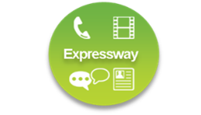
Cisco Jabber Remote Access Options
Layer 3 VPN Solution
Secures the entire device and it’s contents
AnyConnect allows users access to any permitted applications & data
Unified CM
AnyConnect VPN
New Complementary Offering
Session-based firewall traversal
Allows access to collaboration applications ONLY
Personal data not routed through enterprise network
Expressway
Firewall Traversal

Slide 14
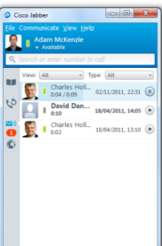
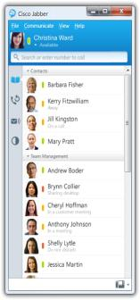
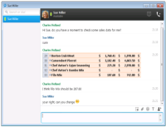

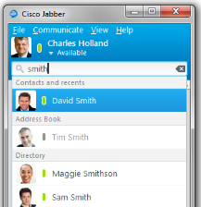


What can a Jabber client do with Expressway?
A fully featured client outside the network
Access visual voicemail
Inside firewall (Intranet)
DMZ
Outside firewall
(Public Internet)
Collaboration Services
Internet
Instant Message and Presence
Unified CM
Expressway
C
Expressway
E
Make voice and video calls
Launch a web conference
Share content
Search corporate directory

Slide 15


Expressway Firewall Traversal Basics
Enterprise Network
DMZ
Outside Network
Internet
Unified CM
Expressway
C
Firewall
Expressway
E
Firewall
Signaling
Media
Expressway E is the traversal server installed in DMZ. Expressway C is the traversal client installed inside the enterprise network.
Expressway C initiates traversal connections outbound through the firewall to specific ports on Expressway E with secure login credentials.
Once the connection has been established, Expressway C sends keep-alive packets to Expressway E to maintain the connection
When Expressway E receives an incoming call, it issues an incoming call request to Expressway C.
Expressway C then routes the call to Unified CM to reach the called user or endpoint
The call is established and media traverses the firewall securely over an existing traversal connection

Slide 16
X8.1 Firewall Traversal Capabilities Expanded
The X8.1 release delivers 3 key capabilities enabling the Expressway Mobile and Remote Access feature
XCP Router for XMPP traffic
HTTPS Reverse proxy
Proxy SIP registrations to Unified CM
(details on new firewall port requirements covered later)
Expressway
C
Firewall
Expressway
E

Slide 17
Solution Components Software Requirements
Component | Min Software Version | Projected Availability
Cisco Expressway or Cisco VCS | X8.1 | Available
Cisco Expressway or Cisco VCS | X8.1.1 (MR) | Q1CY14
Unified CM | 9.1(2) SU1 | Available
Unified CM IM&P | 9.1 | Available
Unity Connection | 8.6(1) | Available
Jabber for Windows | 9.7 | Q1CY14
Jabber for iPhone and iPad | 9.6.1 | Q1CY14
Jabber for MAC | TBD | TBD
Jabber for Android | 9.6 | Q1CY14
EX/MX/SX/C Series TelePresence Endpoints | TC 7.0 | Available

Slide 18
Product Line Options, Licensing, Scalability

Slide 19
X8.1 Product Line Options
X8.1
VCS
Expressway
New Offering
“VCS Control”
No Change
“VCS Expressway”
No Change
“Expressway C”
Or Core
“Expressway E”
Or Edge
Specialized video applications for video-only customer base and advanced video requirements
Superset of X8.1 features
No changes to existing licensing model
Solution designed for and sold exclusively with Unified CM 9.1 and above (including Business Edition)
Subset of X8.1 features
No additional cost for server software licenses

Slide 20
VCS and Cisco Expressway Feature Comparison
Feature Comparison | Cisco Expressway Series | Cisco VCS Family
Mobile and Remote Access | Y | Y
Business to Business Video | Y | Y
Business to Consumer / Public to Enterprise Access with Jabber Guest | Y | Y
Video Interworking (IPv4 to IPv6, H.323-SIP, MS H.264 SVC-AVC, Standards-based 3rd Party Video endpoints) | Y | Y
Video / TelePresence Device Registration & Provisioning | N | Y
Video Session Management & Call Control | N | Y
WebEx Enabled TelePresence | N | Y
Enhanced Security (e.g. JITC) | N | Y
Notes:
Mobile&Remote:
Requires BE6000 / Unified CM 9.1.2 and Jabber 9.6 or later for VPN-less Jabber UC client remote access. VCS also supports Jabber Video for TelePresence (Movi) remote access.
B2C/P2E/Jabber Guest
Requires BE6000 / Unified CM
Registration/Provisioining
Supported in VCS as part of an integrated solution with BE6000 / Unified CM, or as standalone Video Application. Including large scale TelePresence provisioning (with Cisco TMS)
Session Management& Call Control
Supported in VCS as part of an integrated solution with BE6000 / Unified CM, or as standalone Video Application
Webex Enabled TP
WebEx Enabled TelePresence recommended deployment requires MCU / TelePresence Server registered to VCS. Expressway Series does not support registrations.
Enhanced Security
VCS includes JITC, FIPS140-2 compliant modules for federal & security conscious customers.
Mobile & Remote access for Jabber and TP endpoints (registering to UCM) available on VCS
No option key required to enable this feature
Provides existing customers ability to trial new feature on existing infrastructure
Customers encouraged to deploy Expressway for production deployments

Slide 21



Cisco Expressway Licensing
Fixed and Mobile Users at no additional cost
Mobile and Fixed Endpoint registration
IM & Presence
Video and Audio Media Sessions
Includes Virtual Edition Expressway Server Software
No Cost with Unified CM 9.1.2 or later
Expressway
C
Expressway
E
Unified CM 9.1.2 or higher
Internet
Business to Business, Jabber Guest, 3rd party interworking – Concurrent Sessions
Business to Business Video and Audio Media Sessions
Includes Virtual Edition Expressway Server Software
Expressway Rich Media Session licenses available a la carte
Notes:
No option key required for Mobile & Remote Access feature, it is available on X8.1 for both VCS and Expressway
Expressway C and Expressway E servers (virtual applications) available at no additional cost with UCM 9.1.2 or later
Excludes cost of any hardware required (e.g. UCS/3rd party servers or dedicated appliances are additional cost)
Interworking calls and B2B calls (i.e. to endpoints not registered to UCM) require concurrent Expressway Rich Media Session licenses – available a la carte

Slide 22
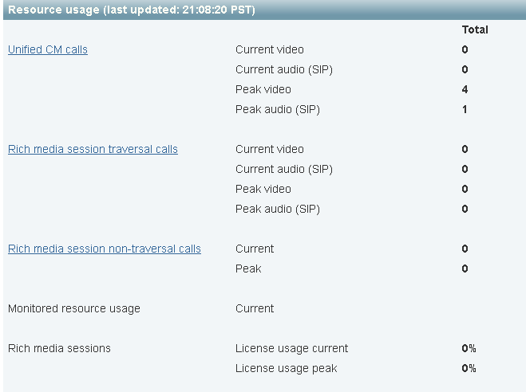
Expressway: “Unified CM Calls”
Calls from endpoints using the Mobile and Remote Access feature are classified as Unified CM calls
Unified CM calls do not consume Rich Media Sessions (Expressway) or Traversal Licenses (VCS)
But Unified CM Calls do count against the overall system capacity

Slide 23
Flexible Call Licensing
X8.1 introduces audio-only classification for SIP traversal or Unified CM calls
Calls with only one m= line in the SDP will be classified as Audio calls
1 Expressway Rich Media Session license allows either 1 video call or 2 audio-only SIP calls
1 VCS Traversal license allows either 1 video call or 2 audio-only SIP calls
Example:
  100 VCS Traversal licenses allows for
  90 video and 20 audio-only simultaneous calls
Session-Expires: 1800
Allow-Events: dialog Recv-Info: x-cisco-conference
Content-Type: application/sdp
Content-Length: 237
v=0
o=tandberg 7 3 IN IP4 182.16.1.115
s=-
c=IN IP4 182.16.1.115
b=AS:64
t=0 0
m=audio 2336 RTP/AVP 8 0 101
b=TIAS:64000
a=rtpmap:8 PCMA/8000
a=rtpmap:0 PCMU/8000
a=rtpmap:101 telephone-event/8000
a=fmtp:101 0-15
a=sendrecv

Slide 24
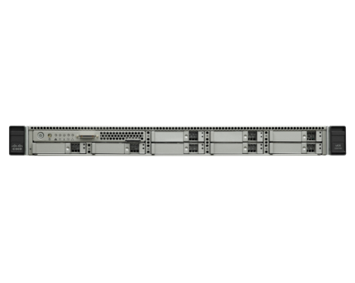


New Compute Platforms for X8
Specs Based
Virtual Machine Support
Appliance Support
Existing VCS Appliance
OVA Size | vCPU | Reserved RAM | Disk Space | vNIC(s)
Small | 2 x 1.8 GHz | 4GB | 132GB | 1Gb
Medium | 2 x 2.4 GHz | 6GB | 132GB | 1Gb
Large | 8 x 3.3 GHz | 8GB | 132GB | 10Gb
New Offering
CE 500
CE 1000
New appliances based on UCS C220 M3
Bare metal – no hypervisor
Fixed configurations for high and low end deployment
Solution for customers with security policies that do not allow VMware in the DMZ
CE500 Single components, 1Gbps interfaces
CE1000 Redundant components, 1 or 10Gbps
Target FCS Q1 CY2014

Slide 25
Expressway X8.1 Scalability
 | Server |  |  | Cluster
Platform | Proxied Registrations | Video Calls | Audio Only Calls | Proxied Registrations | Video Calls | Audio Only Calls
Large OVA | 5,000 | 500 | 1,000 | 20,000 | 2,000 | 4,000
Medium OVA | 2,500 | 100 | 200 | 10,000 | 400 | 800
Small OVA (BE6K) | 2,500 | 100 | 200 | 2,500 | 100 | 200
VCS Appliance | 2,500 | 100 | 200 | 10,000 | 400 | 800
Note: Expressway C&E or VCS-C can be clustered across multiple BE6000s for redundancy purposes, but with no additional scale benefit

Slide 26
Expressway Rich Media Session Licenses
Rich Media Session is the only session license type sold with Expressway (simple!)
Rich Media Session licenses are consumed for either traversal or non-traversal call types
A traversal call will require a Rich Media Sessions license on both the Expressway E and Expressway C
Mobile and Remote Access Feature has no requirements for Rich Media Sessions licenses
Rich Media Sessions should be purchased for Expressways deployed for
  B2B Video
  Jabber Guest
  3rd party video interworking

Slide 27
Expressway License Keys
License Description | PID | Expressway C (EXPWY-VE-C-K9) | Expressway E (EXPWY-VE-E-K9)
X8 Release Key | LIC-SW-EXP-K9 | Included | Included
Expressway Series | LIC-EXP-SERIES | Included | Included
H323-SIP interworking Gateway | LIC-EXP-GW | Included | Included
Traversal Server Feature Set | LIC-EXP-E | N/A | Included
Advanced Networking Option | LIC-EXP-AN | N/A | Included
TURN Relay Option | LIC-EXP-TURN | N/A | Included
Expressway Rich Media Session | LIC-EXP-RMS | Optional | Optional
Microsoft Interoperability Option | LIC-EXP-MSFT | Optional | N/A

Slide 28
Design and Deployment Considerations

Slide 29

Expressway & Jabber Service Discovery
Cisco Jabber Client
DNS SRV lookup _cisco-uds._tcp.example.com
Inside firewall (Intranet)
DMZ
Outside firewall
(Public Internet)
✗
Not Found
Collaboration Services
DNS SRV lookup _collab-edge._tls.example.com
Public DNS
Unified CM
✓
Expressway
C
Expressway
E
expwyNYC.example.com
TLS Handshake, trusted certificate verification
HTTPS: get_edge_config?service_name=_cisco-uds&service_name=_cuplogin

Slide 30
Split DNS SRV Record Requirements
_collab-edge record needs to be available in Public DNS
Multiple SRV records (and Expressway E hosts) can be deployed for HA
A GEO DNS service can be used to provide unique DNS responses by geographic region
_cisco-uds record needs be available only on internal DNS (available to Expressway C at a minimum)
_collab-edge._tls.example.com. SRV 10 10 8443 expwy1.example.com.
_collab-edge._tls.example.com. SRV 10 10 8443 expwy2.example.com.
_cisco-uds._tcp.example.com. SRV 10 10 8443 ucm1.example.com.
_cisco-uds._tcp.example.com. SRV 10 10 8443 ucm2.example.com.

Slide 31
Reverse proxy usage
Initial get_edge_config and internal SRV record request (decrypted)
GET /dWNkZW1vbGFiLmNvbQ/get_edge_config?service_name=_cisco-uds&service_name=_cuplogin HTTP/1.1
Authorization: Basic bWR1ZGU6dGhpc3Bhc3N3ZHdpbGxiZXJlc2V0
Host: collabedge1e.ucdemolab.com:8443
Accept: */*
User-Agent: Jabber-Win-472
Base64 encoded credentials
Base64 decode = ucdemolab.com
Subsequent home cluster discovery request (decrypted)
GET /dWNkZW1vbGFiLmNvbS9odHRwcy9jdWNtLXB1Yi51Y2RlbW9sYWIuY29tLzg0NDM/cucm-uds/clusterUser?username=mdude HTTP/1.1
Host: collabedge1e.ucdemolab.com:8443
Accept: */*
Cookie: X-Auth=7f501814-e61f-483a-8620-ed0b5d3792db
User-Agent: Jabber-Win-472
X-Auth token
Base64 decode = ucdemolab.com/https/cucm-pub.ucdemolab.com/8443
Not a general purpose reverse proxy, intended for Cisco clients only!

Slide 32
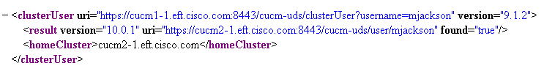
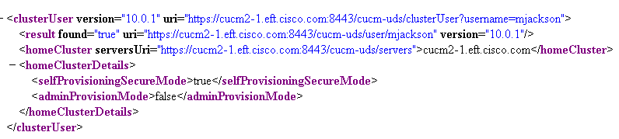
Home Cluster Discovery
Expressway C will use the following UDS API to determine a user’s home cluster
https://<UCM>/cucm-uds/clusterUser?username=<USERNAME>
Unified CM 9.1.2
Unified CM 10.0

Slide 33



Protocol Workload Summary
Inside firewall (Intranet)
DMZ
Outside firewall
(Public Internet)
Protocol | Security | Service
SIP | TLS | Session Establishment – Register, Invite, etc.
Media | SRTP | Audio, Video, Content Share, Advanced Control
HTTPS | TLS | Logon, Provisioning/Configuration, Contact Search, Visual Voicemail
XMPP | TLS | Instant Messaging, Presence
Collaboration Services
Internet
Unified CM IM&P
Conference Resources
Other UC Infrastructure & Resources
Unified CM
Expressway
C
Expressway
E
Notes:
No traversal support for CTI/QBE, CAPF certificate enrollment

Slide 34

Hybrid Deployment - Cloud based IM&P
Inside firewall (Intranet)
DMZ
Outside firewall
(Public Internet)
Protocol | Security | Service
SIP | TLS | Session Establishment – Register, Invite, etc.
Media | SRTP | Audio, Video, Content Share, Advanced Control
HTTPS | TLS | Logon, Provisioning/Configuration, Contact Search, Visual Voicemail
XMPP | TLS | Instant Messaging, Presence
Collaboration Services
Internet
Conference Resources
Other UC Infrastructure & Resources
Unified CM
Expressway
C
Expressway
E
webex
Messenger

Slide 35



Contact Search Considerations (Cloud based IM&P)
Jabber allows for multiple contact source integrations
LDAP Directory sync provides corporate directory to Unified CM
Corporate directory is also exported to WebEx Messenger cloud
All Jabber clients will use WebEx Messenger cloud as a contact source for contact search
Inside firewall (Intranet)
DMZ
Outside firewall
(Public Internet)
Collaboration Services
Internet
Unified CM
Expressway
C
Expressway
E
sync
webex
Messenger
LDAP

Slide 36
Contact Search Considerations (on-premise IM&P)
Jabber allows for multiple contact source integrations
LDAP Directory sync provides corporate directory to Unified CM
User Data Services (UDS) is a Unified CM RESTful API allowing for contact search, among other things
All Jabber clients connecting via Expressway will use UDS for contact search
Jabber clients deployed on-premise will use LDAP for directory search
Jabber clients will automatically use UDS for directory search when connecting via Expressway
The entire corporate directory needs to be sync’d on every Unified CM cluster for best contact search experience
Inside firewall (Intranet)
DMZ
Outside firewall
(Public Internet)
UDS
Collaboration Services
Internet
Unified CM
Expressway
C
Expressway
E
sync
EDI/BDI
LDAP
Notes:
UDS Scale limitations
Limit of 80K end users in standard UCM database (no hard enforcement within the application)
160K w/ BU megacluster team approval

Slide 37
Media Path Summary
Media Traversal
“C” calls “A” on-premise
Expressway solution provides firewall traversal for media
Expressway C de-multiplexes media and forwards toward “A”
Unified CM provides call control for both mobile and on-premise endpoints
B
Inside firewall (Intranet)
DMZ
Outside firewall
Media Relay
“C” calls “B” off-premise
Media is relayed via Expressway C
Collaboration Services
Internet
C
Unified CM
Expressway C
Expressway
E
Optimized Media (roadmap ICE support)
“B” calls “D” off-premise
Both “B” and “D” are ICE-enabled
STUN binding success
Media flows are optimized between endpoints
SIGNALING
D
MEDIA
A
Notes:
ICE support (roadmap) allows for optimized media and also the usage of the TURN server on Expressway E, which is the last resort for ICE candidate negotiations

Slide 38
Expressway Clustering, 4+2
Cluster Expressways for scale and redundancy
Expressway Clusters support up to 6 peers
Expressway E and C node types cannot be mixed in the same cluster
Deploy equal number of peers in Expressway C and E clusters
Deploy same OVA sizes throughout cluster
Expressway remote access is limited to one customer domain per cluster
However customers can deploy multiple clusters for the same customer domain

Slide 39
Mobile & Remote Access Deployment Options
Customer domain shared across all Unified CM & IM&P clusters
Unified CM Clusters | Expressway C Clusters | Expressway E Clusters | Comments
1 | 1 | 1 | Single Expressway deployment providing remote access to a central Unified CM cluster
1 | 2+ | 2+ | Regional Expressway deployments providing remote access to a central Unified CM cluster
2+ | 1 | 1 | Single Expressway deployment providing remote access to a multiple Unified CM clusters
2+ | 2+ | 2+ | Regional Expressway deployments providing remote access to multiple Unified CM Clusters
same customer domain is shared across all Unified CM & IM&P clusters

Slide 40

Global Deployment Topology & Geo DNS
DNS SRV lookup
_collab-edge._tls.example.com
Geo DNS
expwy.us.example.com
expwy.jp.example.com
US
Europe
Asia
SIP Trunk
SIP Line
Expressway Traversal
expwy.uk.example.com
Expressway
edge access
SME global
aggregation
Asia SME
EU SME
US SME
Unified CM regional
clusters
RTP
PAR
LON
TKY
BGL
SJC
DFW
AMS
HKG
Notes:
Geo DNS provides DNS responses based upon src ip address
No option for remote access session aggregation at SME layer

Slide 41
Unsupported Features
Mobile & Remote Access
CTI phone control
CAPF client certificate provisioning
Jabber file transfer (supported only in hybrid IM&P deployment)
    Jabber Mobile features include DVO-R, GSM handoff, session persistency
    TC Endpoint OBTP
    TC Endpoint management (SNMP, SSH/HTTP access)
    Media Path Optimization (ICE)
    Early Media

Slide 42
Unsupported: Unbalanced Expressway Deployments
This model is still supported for traditional VCS Expressway deployments
But this is not supported for the new mobile and remote access functionality introduced in X8.1
Expressway X8.1 remote access requires a Expressway C cluster for each Expressway E cluster
Only one “Mobile & Remote Access” enabled Traversal zone per cluster
Inside firewall (Intranet)
DMZ
Outside firewall
(Public Internet)
Collaboration Services
Unified CM
Expressway
C
Expressway E
Cluster A
Internet
Expressway E
Cluster B

Slide 43
Unsupported: Expressway Chained Traversal
Chained traversal is often used in environments with heightened security policies
This option is still supported for traditional VCS deployments, or Expressway deployments do not require the remote and mobile access feature
Not supported for the new mobile and remote access functionality introduced in X8.1
Only one “Mobile & Remote Access” enabled Traversal zone per cluster
Inside firewall (Intranet)
DMZ
B
DMZ
A
Outside firewall
(Public Internet)
Collaboration Services
Internet
Unified CM
Expressway
C
Traversal Client
Expressway
E
Traversal Server &
Traversal Client
Expressway
E
Traversal Server

Slide 44
Existing VCS Customers
Customers with VCS-C and VCS-E can add Mobile and Remote Access to an existing deployment
Simply add a parallel traversal zone on existing VCSs to support mobile and remote access
Ideal for mid-market customers, POCs, or pilot programs
Concurrent session scale is the primary reason for adding Expressways dedicated to Mobile & Remote access
  Will the number of remote Jabber users making calls over Expressway crush my existing TelePresence deployment?
The difference in security posture between B2B video and remote access solutions is another consideration
  Does it makes sense for the customer to combine these solutions on the same VMs?

Slide 45
Parallel Deployments of VCS & Expressway
_collab-edge SRV records don’t conflict with existing VCS SRV record usage
B2B Video SIP & H.323 (inbound & outbound)
Cisco Jabber Video for TelePresence Registration
Cisco TelePresence Endpoints (TC) Registration to VCS
WebEx Enabled TelePresence (outbound)
Collaboration Services
Unified CM
VCS-C
VCS-E
Cisco Jabber Registration
Cisco TelePresence Endpoints (TC) Registration to UCM
Expressway
C
Expressway
E
Add _collab-edge SRV to Public DNS

Slide 46
AnyConnect & Expressway Coexistence
Customers that have deployed AnyConnect can also deploy Expressway Mobile & Remote Access feature
For the best end user experience, prevent all Jabber traffic from using the AnyConnect tunnel
  ☹ Active calls going though Expressway will be dropped if AnyConnect tunnel is established mid-call
☺ Expressway can provide Jabber client access to on-prem collaboration services even with an active AnyConnect tunnel established
Requirements to keep Jabber traffic going through Expressway
  AnyConnect split tunnel providing connectivity to internal enterprise network only (not including Expressway E)
  Deny access (ASA DNS inspection) to the internal DNS SRV records (_cisco-uds & _cuplogin) to AnyConnect clients

Slide 47
Expressway Configuration

Slide 48
Expressway Configuration Summary
Enable Mobile & Remote Access feature, Configuration > Unified Communications
Provide IM&P Publisher address and supply admin credentials for each IM&P cluster (not required for hybrid deployments)
Provide Unified CM Publisher address and supply admin credentials for each Unified CM cluster
  Expressway C connects to each Publisher and discovers all cluster nodes
  Neighbor Zone auto-generated for each Unified CM node
  Search Rules auto-generated for each Unified CM node
Add the customer domain and select services
Generate certificate signing requests and procure CA signed certs
Configure Traversal Zone with Mobile & Remote Access feature enabled

Slide 49
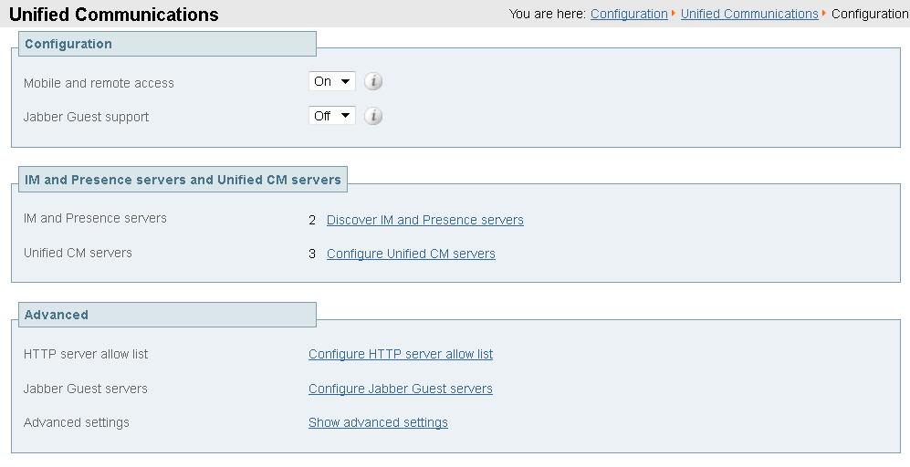
Unified Communications Configuration
Expressway C

Slide 50
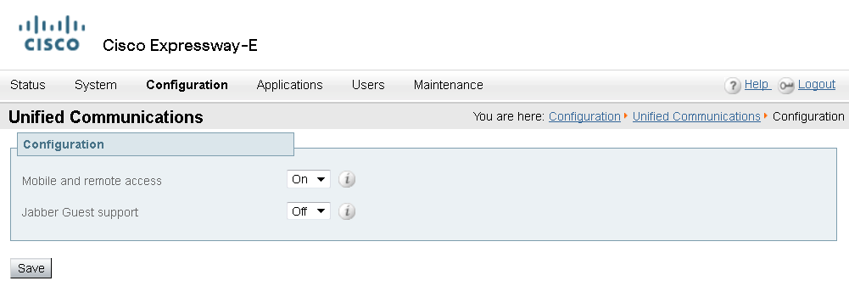
Unified Communications Configuration
Expressway E

Slide 51
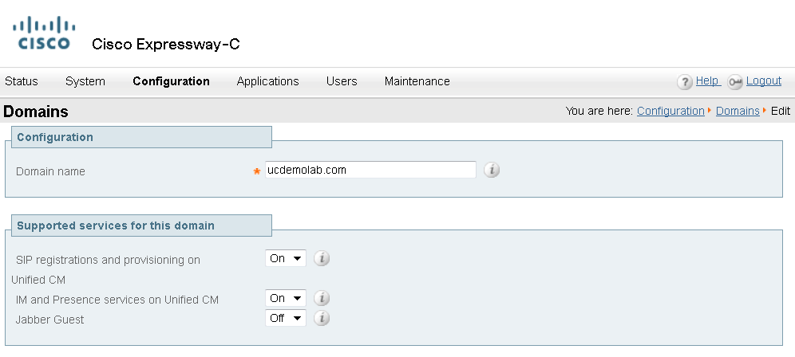
Expressway C Domain Configuration
Note: no domain configuration required on Expressway E

Slide 52
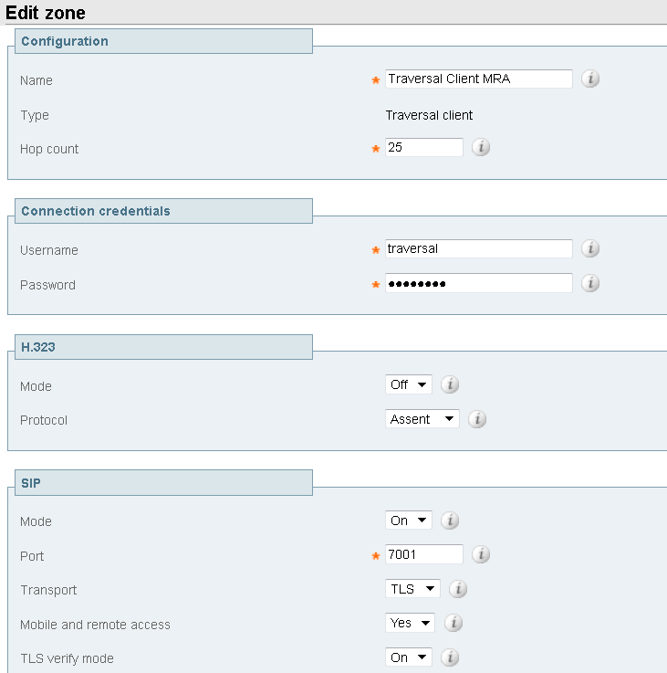
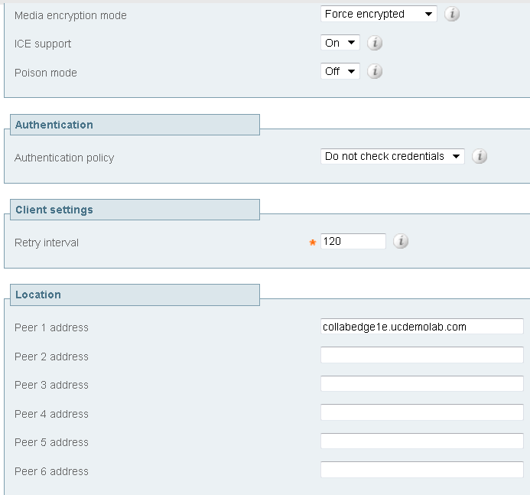
Expressway C Traversal Client Zone

Slide 53
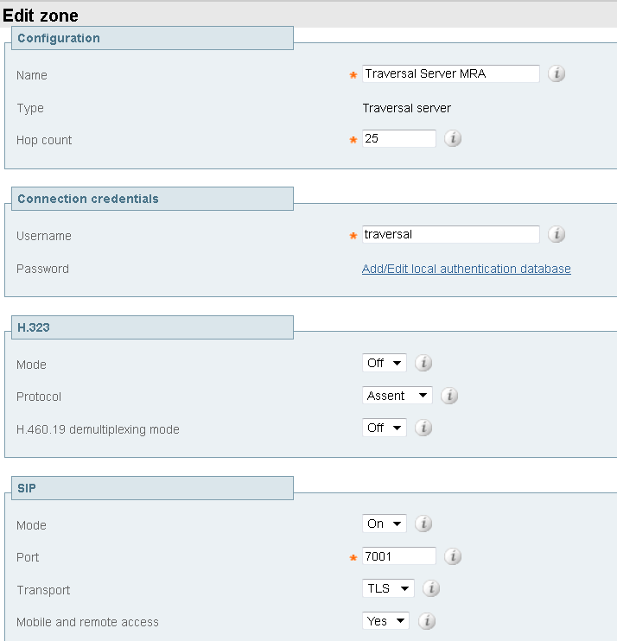
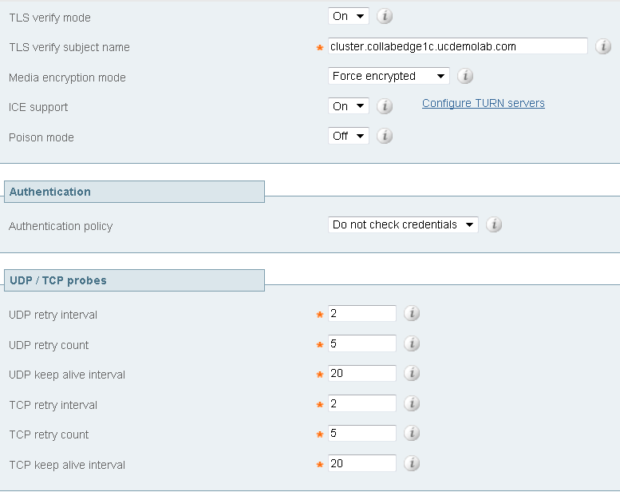
Expressway E Traversal Server Zone

Slide 54
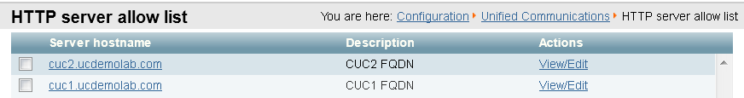
Allowed Reverse Proxy Traffic
Expressway E server will be listening on TCP 8443 for HTTPS traffic
Basic mobile & remote access configuration allows inbound authenticated HTTPS requests to the following destinations on the enterprise network
      All discovered Unified CM nodes TCP 6970 (TFTP file requests) & TCP 8443 (UDS API)
      All discovered IM&P nodes TCP 7400 (XCP Router) & TCP 8443 (SOAP API)
HTTPS traffic to any additional hosts need to be administratively added to the Expressway C allow list
Allow list provides a mechanism to support Visual Voice Mail access, contact photo retrieval, Jabber custom tabs, etc.

Slide 55
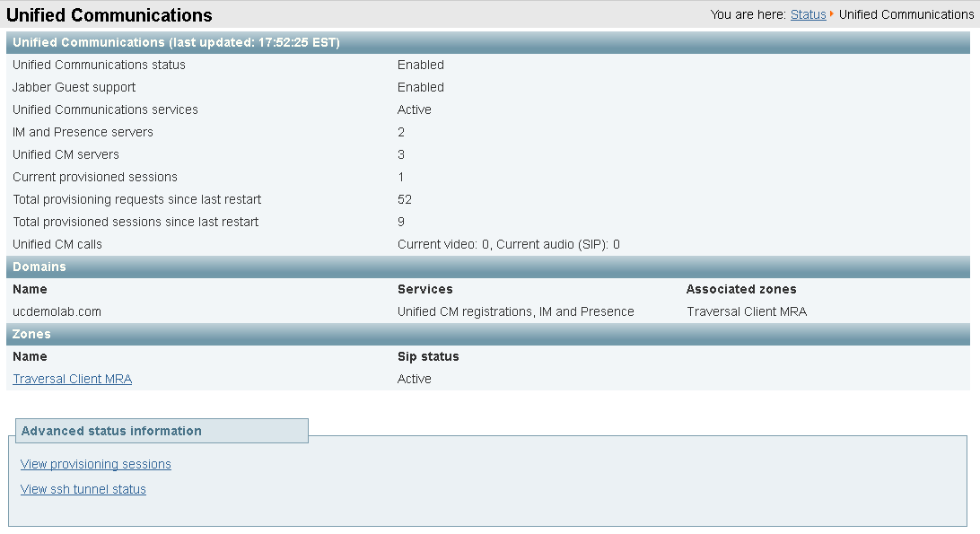
Expressway C Unified Communications Status
Status > Unified Communications

Slide 56
Unified CM Requirements

Slide 57
Expressway Remote Access
from Unified CM perspective
Remote access provided by Expressway is, for the most part, transparent to Unified CM
Think SIP line integration, versus SIP trunk
No requirement to build a SIP trunk on Unified CM to Expressway C or E
No requirement to make dial plan changes
No remote access policy mechanism to limit edge access to certain Jabber users or devices
Remote Jabber clients or TelePresence Endpoints registering to Unified CM through Expressway will appear to Unified CM as Expressway-C IP address (opportunity for Unified CM Device Mobility feature usage)

Slide 58
Interaction with SIP trunk
SIP trunk not required between Expressway C (or VCS-C) and Unified CM for Mobile & Remote Access
However, if Unified CM includes a SIP trunk for other integrations, Unified CM will reject any SIP registration attempts from remote Jabber or TP endpoints, as the register method is not accepted on Unified CM SIP trunk interface
Update Unified CM SIP trunk security profile to listen on ports other than TCP 5060 or 5061 (you could use 5560, 5561, etc.)
Port change allows for SIP trunk integration AND mobile & remote access
SIP Trunk can interfere with remote registrations
Inside firewall (Intranet)
DMZ
Outside firewall
(Public Internet)
Collaboration Services
Internet
Unified CM
VCS Control
VCS Expressway
SIP Video Endpoints
H.323 Video Endpoints
SIP 405 will be returned to SIP Register request if there is SIP trunk port conflict

Slide 59
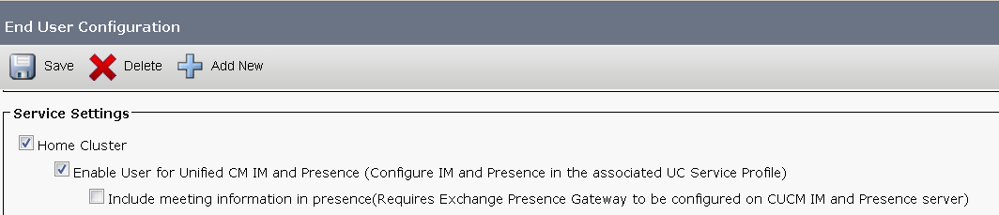
UDS Directory Search
All Jabber clients connecting via Expressway will use UDS for directory search (assuming Unified CM IM&P deployment)
TelePresence endpoints always use UDS for directory search
For the best contact search experience, all Enterprise Users should be imported into every Unified CM cluster’s end user table
Home cluster check box needs to be selected on only one cluster for each user
Unified CM clusters support 80K end users, and can scale as high as 160K with BU megacluster approval

Slide 60
Pre-requisites to supporting multiple Unified CM Clusters
Cross cluster UDS API calls are used to find Jabber user’s home cluster
https://<ucm>/cucm-uds/clusterUser?username=mdude
Intercluster Lookup Service (ILS) networking needs to be established enterprise Unified CM clusters to allow for Unified CM cluster discovery
SIP URI replication over ILS is optional, not a requirement
Unified CM’s Tomcat certificates need to be exchanged between Unified CM clusters for UDS clusterUser API calls to work

Slide 61
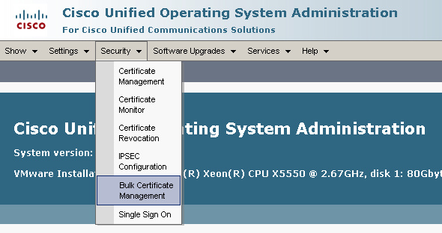


Unified CM Bulk Certificate Management
Tool used to simplify Unified CM Cluster certificate exchange
All Clusters export TFTP (CallManager), Tomcat, and CAPF certificates to central SFTP server
Certificates are consolidated into PKCS12 files
Consolidated set of certificates are then imported to each publisher
Cisco Certificate Change Notification Service replicates trusted certificates throughout the cluster
SFTP
Server
Notes:
Export:
This step creates a PKCS12 file that contains certificates for all nodes in the cluster.
Every participating cluster must export certificates to the same SFTP server and SFTP directory.
A cluster must export its certificates whenever the Tomcat, TFTP, CAPF certificate(s) are regenerated on any of its nodes.
Consolidate:
This step consolidates all PKCS12 files in the SFTP server to form a single file.
Only one of the participating clusters needs to perform consolidation.
If new certificates are exported after they are consolidated, consolidation needs to be performed again to pick up the newly exported certificates.
Import:
This step imports the consolidated PKCS12 files from the SFTP server into the local cluster.
All clusters should re-import when any participating cluster makes an export.
Perform import after a central administrator consolidates the certificates.

Slide 62
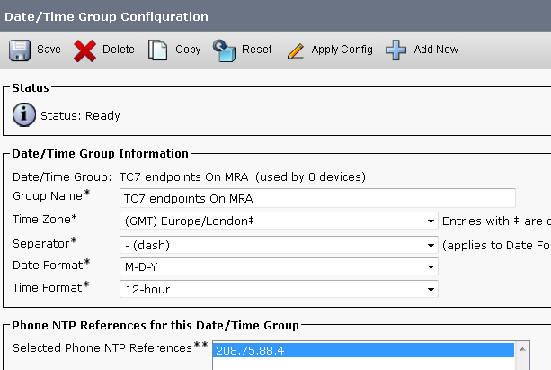
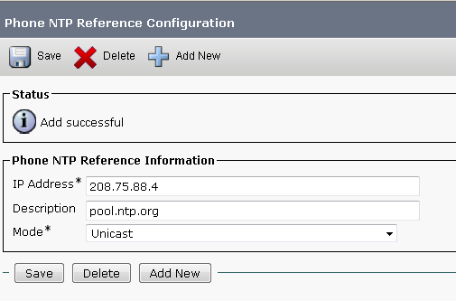
External NTP source for TC endpoints
TC endpoints registered to Unified CM will try to use Unified CM as an NTP server
NTP is not supported over Expressway Traversal, so use an external reference instead
1. Create a new Phone NTP Reference pointing to a public NTP server
2. Create a Date/Time Group using the public NTP reference
3. Apply to remote TC7 endpoints’ device pool

Slide 63
Security

Slide 64
Firewall Port Details
No inbound ports required to be opened on the internal firewall
Internal firewall needs to allow the following outbound connections from Expressway C to Expressway E
  SIP: TCP 7001
  Traversal Media: UDP 36000 to 36011
  XMPP: TCP 7400
  HTTPS (tunneled over SSH between C and E): TCP 2222
External firewall needs to allow the following inbound connections to Expressway
    SIP: TCP 5061
    HTTPS: TCP 8443
    XMPP: TCP 5222
    Media: UDP 36002 to 59999
    TURN server control: UDP 3478 – 3483
    TURN server media : UDP 24000 – 24999
Jabber Guest, not required for Mobile & Remote Access

Slide 65
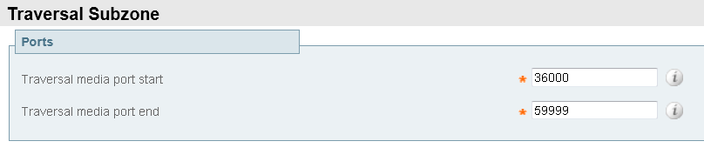
Media Port Range Expansion
X8.1 scalability improvements require a media port range expansion
X8.1 default media Port Range is now UDP 36000 – 59999
VCS systems upgraded from X7 to X8.1 will need to manually update port range, Configuration > Local Zone > Traversal Subzone
Notes:
Defaults for X7.2 were 50000-54999

Slide 66
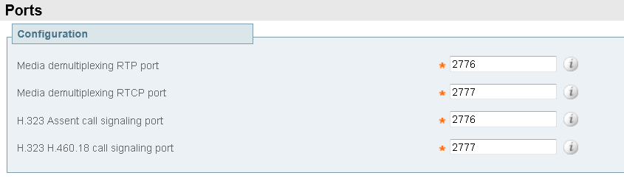
Traversal Media Port Changes
Important change for existing VCS customers to understand
X7 release included the ability to configure the Expressway Media demultiplexing RTP port and RTCP port
Upon upgrading to X8.1 the traversal media ports are automatically migrated to the first 2 ports in the current media port range (details on previous slide)
Customers will need to coordinate X8.1 upgrade with firewall port change
New X8.1 installs on the Large OVA will use UDP 36000 – 36011, the expanded port range is required to support scalability improvements
Configuration Removed in X8.1

Slide 67
Client Authentication at the Edge
HTTPS
Clients supply base64 encoded username and password to authenticate over HTTPS Authorization: Basic bWR1ZGU6dGhpc3Bhc3N3ZHdpbGxiZXJlc2V0
Credentials are forwarded to Expressway C and then used to authenticate against Unified CM, upon determination of the user’s home cluster
Upon successful authentication, X-Auth token provided for future HTTPS requests (8 hour lifetime) Cookie: X-Auth=7f501814-e61f-483a-8620-ed0b5d3792db
SIP
SIP Digest authentication used to authenticate the users registering on tcp 5061
Mutual TLS can be enforced on Expressway E by enabling default zone access rules
Notes:
Only client certificate option is LSC from CAPF service on UCM Publisher
LSC enrollment with CAPF is not supported over Expressway traversal

Slide 68
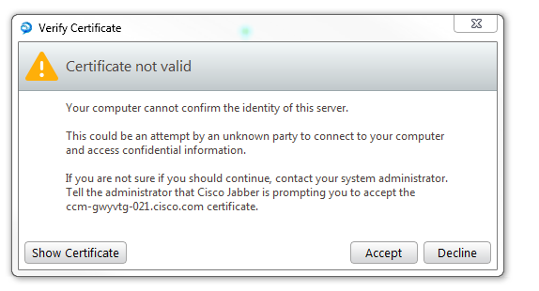
Edge Server Authentication
No matter which client authentication model is deployed, server authentication is always performed by the remote device
i.e. remote Jabber clients and remote endpoints will always validate the Expressway E Server Certificate presented in the TLS handshake
Jabber Clients will rely on the underlying platform trusted CA list
TelePresence Endpoints will rely on a trusted CA list included in firmware
No CTL requirement for Edge Server authentication

Slide 69
Expressway Server Certificates

Slide 70
Expressway Server Certificates
Expressway E Server certificates should be signed by 3rd party Public CA
Expressway C server certificates can be signed by 3rd party Public CA or Enterprise CA
Expressway server certificates need to allow for both client & server authentication
Public CA signed certificates allow Jabber clients and endpoints to validate the server certificate without a CTL
Jabber clients with a CTL will not use the CTL to validate Expressway certificate - no requirement to include Expressway certs in CTL
No support for wildcard certificates
Don’t upload stacked certificates, separate signed server cert from CA chain
X.509v3
X509v3 Extended Key Usage:
TLS Web Client Authentication
TLS Web Server Authentication

Slide 71
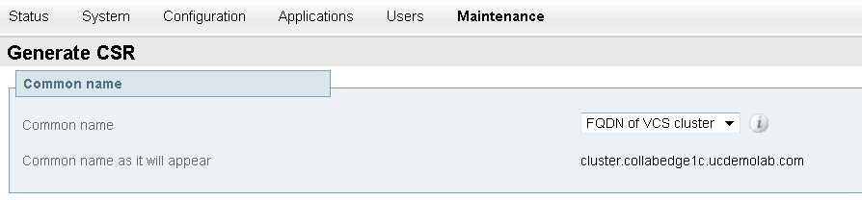
Expressway Certs and Clustering
Set a cluster name (System > Clustering) even when starting with a single node
Generate server certificate CSR with Common Name set to “FQDN of VCS Cluster”
Build Expressway E Traversal Server zone with the “TLS verify subject name” set to “Cluster FQDN”

Slide 72
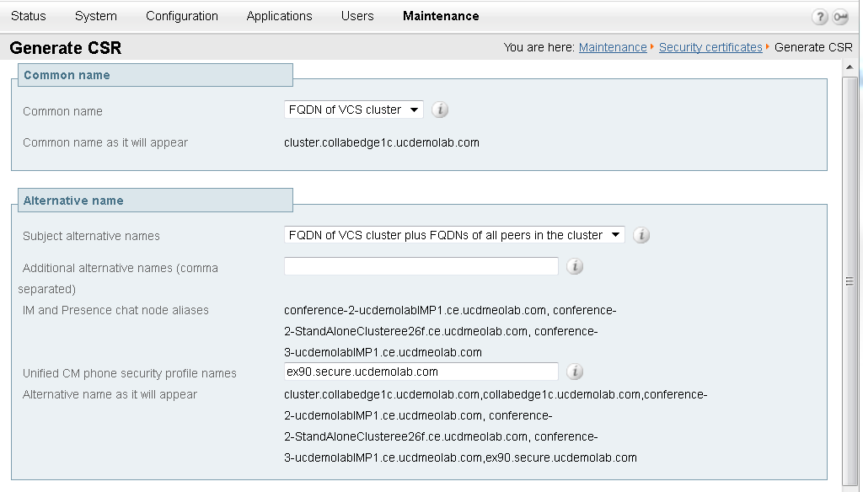
Expressway Certificate Signing Request (CSR)
Maintenance > Security Certificates > Server Certificate
Click
to load this page ----->

Slide 73
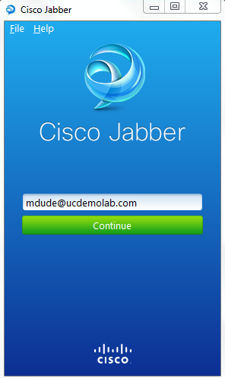
Cert Subject Alternative Name (SAN) requirements
Customer’s primary domain required to be included as a DNS SAN in all Expressway E server certificates
Primary domain as in example.com or cisco.com or
This domain is used for SRV lookups and extracted from here
This is a security measure that allows clients to verify connections to edge servers authoritative for their domain (RFC 6125)
DNS X509v3 Subject Alternative Name: DNS:ucdemolab.com

Slide 74
Unified CM Mixed Mode & Expressway SANs
Expressway C Server Certificate Generation CSR page will also include the option to include Unified CM security profile names as additional SANs
This is only required in deployments that include encrypted security profiles (requires Unified CM to be in mixed mode with CTL deployed)
The Expressway C server certificate will be presented to Unified CM during the TLS handshake on behalf of remote endpoints with encrypted security profiles
Unified CM needs to find a match between the Expressway certificate’s CN or SAN and the phone security profile name to authorize the TLS registration on TCP 5061
Unified CM phone security profile names cannot be shared across device types
DNS X509v3 Subject Alternative Name: DNS:secure.ex90.ucdemolab.com

Slide 75
Optional SANs for future usage
The Expressway Server Certificate Generate CSR page will also insert “chat node aliases” as SANs
These specific SANS will allow for TLS XMPP federation
There will be 1 chat node alias per deployed Unified CM IM&P server
Expressway XMPP federation is still a roadmap feature, but this inclusion will potentially save customers from having to get new certificates signed in the future when deploying XMPP federation
X509v3 Subject Alternative Name: DNS:conference-2-StandAloneCluster9c265.ucdemolab.com
X.509v3

Slide 76
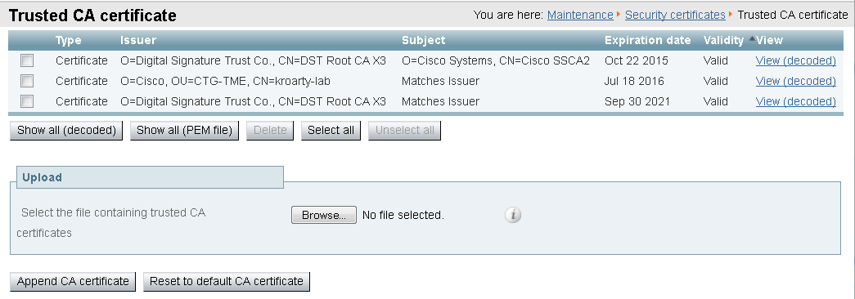
Expressway Trusted CA Certificates
Trusted CA certificates can now be viewed in either a decoded human-readable format, or in base64 encoded PEM format
X8.1 release will not include the default trusted CA certificate list
VCS customers upgrading from X7 or prior should consider purging this list

Slide 77
Expressway Trusted CA Certificates
Certificate Type | Expressway C | Expressway E | Comments
Public CA cert chain used to sign Expressway E certificate | ☑ | ☑ | Required to establish Traversal Zone connections
Public or Enterprise CA cert chain used to sign Expressway C certificate | ☑ | ☑ | Required to establish Traversal Zone connections
Unified CM Tomcat certificates or CA chain | ☑ | ☒ | Only required when Expressway C configured to use TLS Verify mode on Unified CM discovery
Unified CM CallManager certificates or CA chain | ☑ | ☒ | Only required when Unified CM is in mixed mode for end to end TLS
Unified CM IM&P Tomcat certificates or CA chain | ☑ | ☒ | Only required when Expressway C configured to use TLS Verify mode on IM&P discovery
Unified CM CAPF certificate(s) | ☒ | ☑ | Only required when remote endpoints authenticate with LSC certificate

Slide 78
Closing Thoughts

Slide 79
High Level Deployment Guidance
Start on solid ground
  Jabber service discovery needs to work on-prem
  Start on-prem and then add edge access
  Verify end user home cluster discovery in multi Unified CM cluster deployments
Don’t forget about DNS
  Understand split DNS SRV requirements, get DNS change requests in the queue
  A common DNS domain simplifies matters
Review TCP and UDP port requirements with firewall team
Verify Expressway CA signed certs
  Confirm SANs returned in CA signed cert match what was requested in the CSR
  Verify cert includes both TLS Web Server & Client Authentication Extended Key Usage

Slide 80
Key Takeaways
Cisco Expressway: a new product offering specifically for Unified CM 9.1+ and Business Edition customers, available today!
Expressway is easy to deploy with no added costs for mobile & remote users
Provide simple and secure Jabber VPN-less access with Expressway Mobile & Remote Access
Cisco VCS includes the superset of X8 software features
Cisco Expressway includes a subset of X8 software features
AnyConnect and Expressway are complementary remote access solutions that can co-exist

Slide 82
Q&A

Slide 84
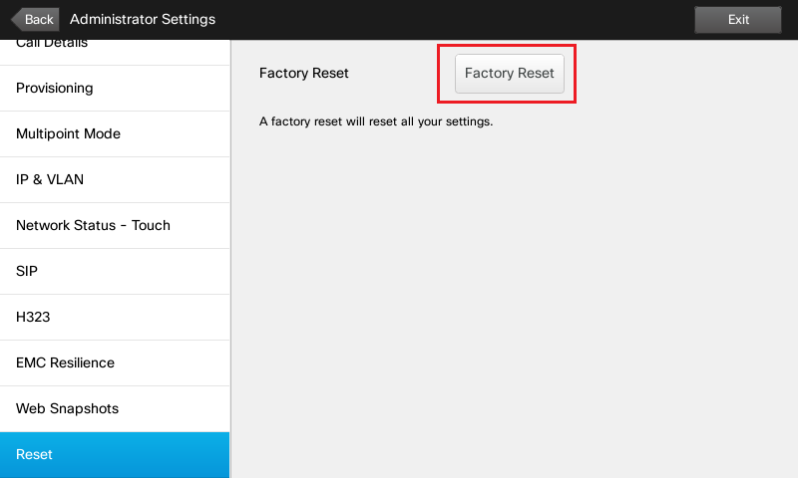
TC 7.0.1 Endpoint Provisioning

Slide 85
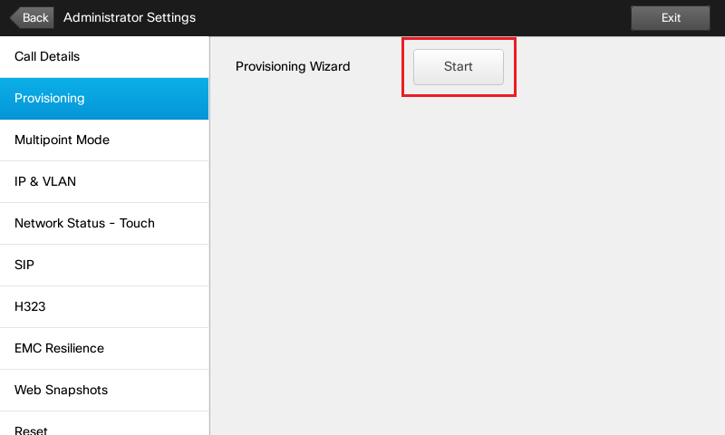
TC 7.0.1 Endpoint Provisioning

Slide 86
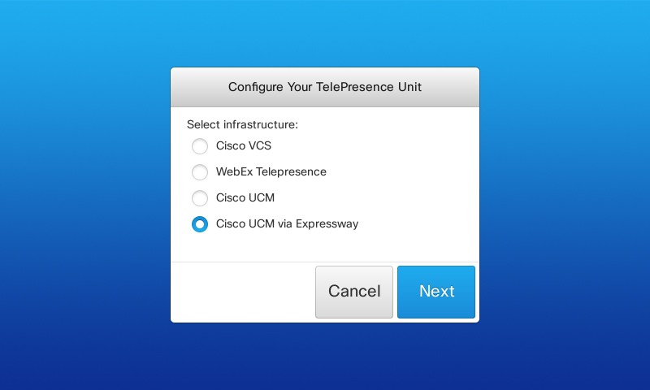
TC 7.0.1 Endpoint Provisioning

Slide 87
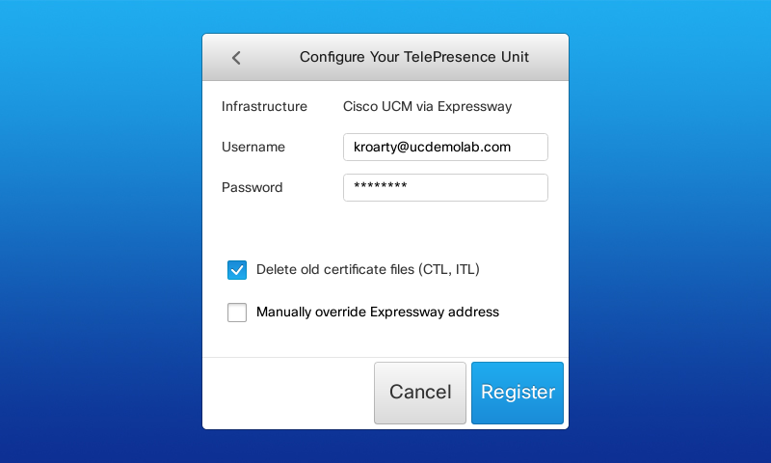
TC 7.0.1 Endpoint Provisioning

Slide 88
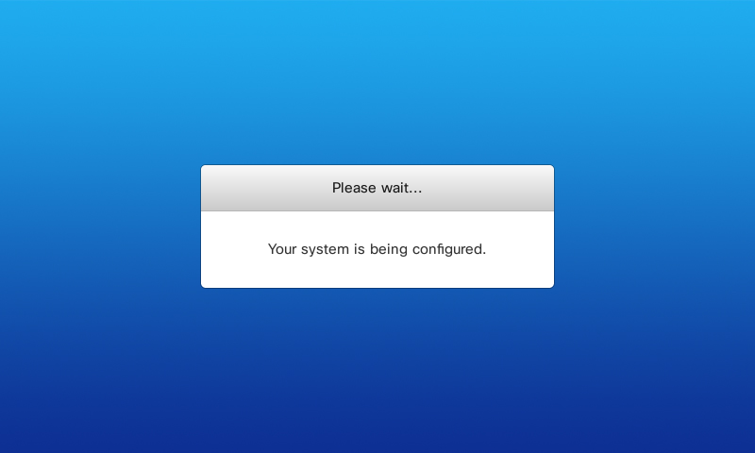
TC 7.0.1 Endpoint Provisioning

Slide 89
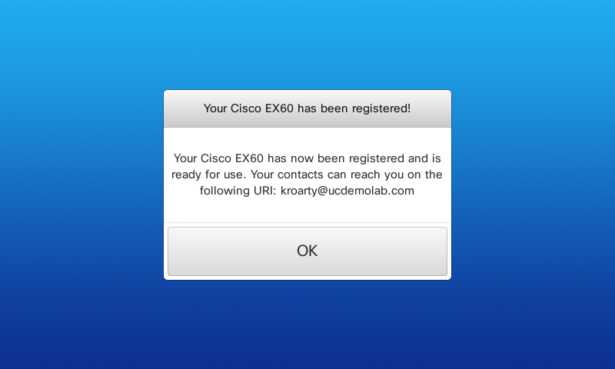
TC 7.0.1 Endpoint Provisioning

Slide 90
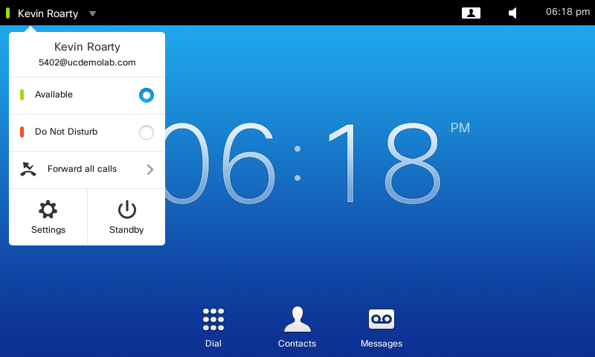
TC 7.0.1 Endpoint Provisioning

Slide 91
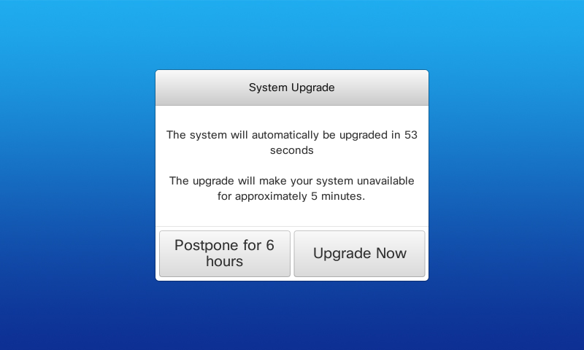
TC 7.0.1 Endpoint Provisioning

