Slide 1
Call Progress Analysis (CPA) Tuning / Best Practices

Slide 2
Call Progress Analysis
Provides detection of :
Performed at the start of each call
Should be tuned to meet Contact Management Needs
Campaign reports contain call progress results
Controlled on per campaign basis
Can be turned off
Effectiveness depends on tuning
SIT Tones | Answering Machines
Fax Machines | Beep Tone After Message
Modems | Network Voicemail

Slide 3
Answering Machine Detection (AMD) Algorithm Description
The algorithm measures the energy level in the packets to determine the difference between “speech” (high energy) and “silence” (low energy).
After connecting to a dialed number, it looks for a sufficiently long silent period following a speech period to designate the call as “Voice”. If one isn’t found, the call is designated as “Answering Machine”.
The short time zero crossing rate is used to determine if the energy detected is speech or a sinusoidal tone (or a pair of tones such as with DTMF). The CPA algorithm will reject tones and not mistake them for possible speech.
Answering machine messages can be very diverse, may include background noise, etc. all affecting the algorithm and its decision making process.

Slide 4
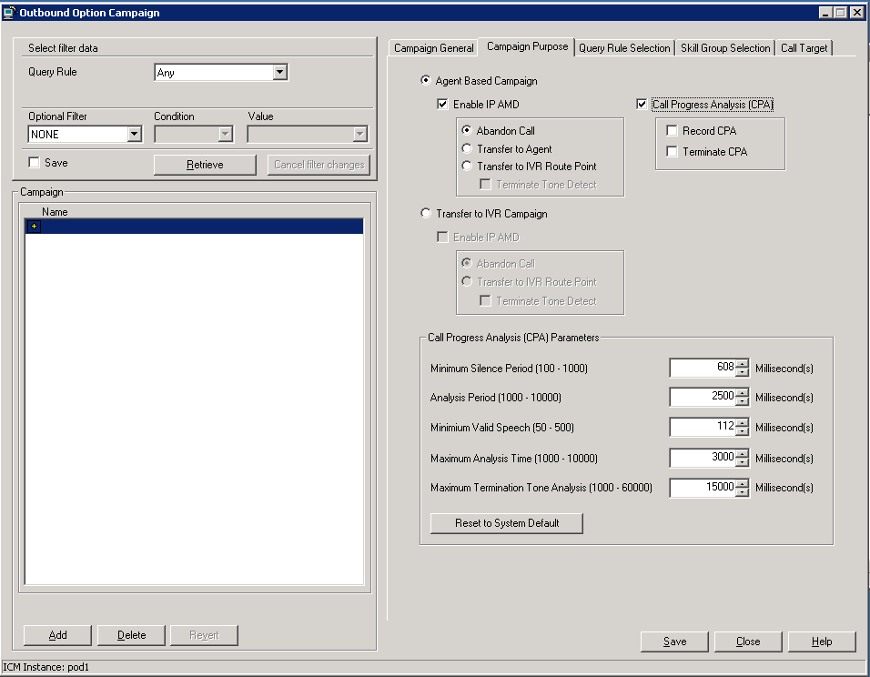
CPA Settings
CPA Parameters are now Campaign Specific and managed in the Campaign Configuration tool.

Slide 5
CPA Parameter Definitions
Parameter (7.5 Registry Key) | Default Value (units) Range | Definition
Minimum Silence Period (CPAMinSilencePeriod) | 608 (ms) 100 - 1000 | Amount of time that the signal must be silent after speech detection to declare a live voice.
Analysis Period (CPAAnalysisPeriod) | 2500 (ms) 1000 - 10000 | Amount of time (from the moment the system first detects speech) that analysis will be performed on the input audio.
Minimum Valid Speech Period (CPAMinimumValidSpeechTime) | 112 (ms) 50 - 500 | Amount of time that energy must be active before declared speech. Anything less is considered a glitch.
Maximum Analysis Time (CPAMaxTimeAnalysis) | 3000 (ms) 1000 - 10000 | The period in which Analysis Period must start or voice will be declared. This timer starts at off-hook.
Maximum Termination Tone Analysis (CPAMaxTermToneAnalysis) | 30000 (ms) 1000 - 60000 | This is the amount of time the algorithm will look for a terminating “beep” once the algorithm has detected an answering machine

Slide 6
CPA – Live Voice Example
voice
energy
“Hello”
time
CPAAnalysisPeriod
CPAMaxTimeAnalysis
Live Voice Declared
&
Redirect to Agent
CPAMinSilencePeriod
Minimum Valid SpeechTime

Slide 7
CPA – Answering Machine Example
voice
energy
Answering Machine Declared
“Hello. Please leave a
message after the beep.”
B
E
E
P
Redirect to Route Point
time
CPAAnalysisPeriod
CPAMaxTermToneAnalysis
CPAMaxTimeAnalysis
CPAMinimumValidSpeechTime
Notes:
7

Slide 8
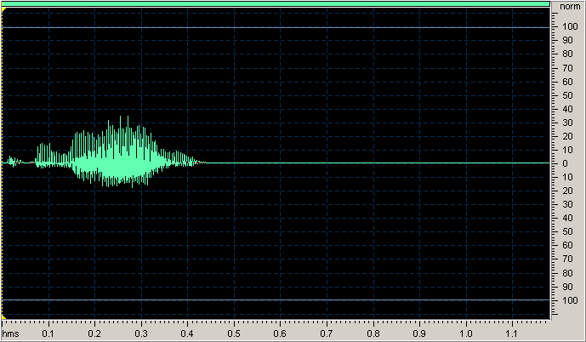
Live Voice Example – “Hello”
Voice Energy
Minimum Silence Period
(750 ms)
No additional voice energy detected after start of silence period. Call is designated as “Voice”
Minimum Valid Speech Period
Notes:
In this case the customer was trying to tune their AMD to correctly identify as many AM as possible to avoid sending them to the Agents.
Tuning of the algorithm is a standard practice

Slide 9
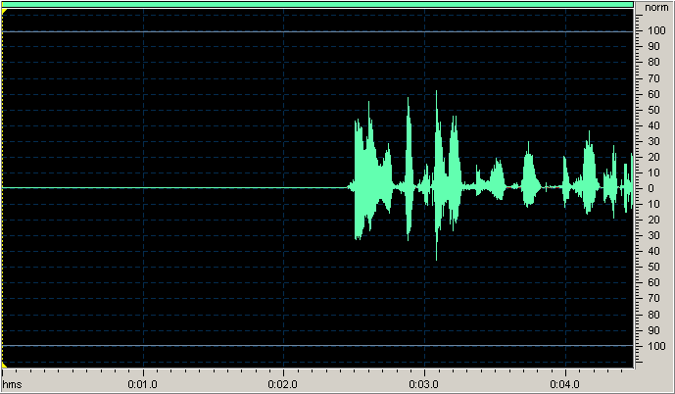
Answering Machine Example – “Hi you’ve reached the Hasson residence…”
Analysis Period
No gaps of 750 ms in message, call is designated as an “Answering Machine”
Voice Energy
Minimum Valid Speech Period
Notes:
This customer’s campaign was set up to drop AM calls, so there is no need to try to detect a beep.
Analysis period was set up to be 2000 ms for this customer.

Slide 10
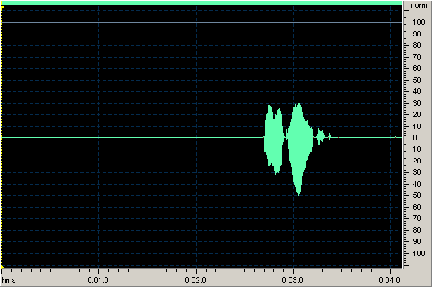
CPA Challenges – Incorrect Designation
Minimum Silence Period
(750 ms)
Voice Energy
Call designated as Voice because of the silence after the speech.
Minimum Valid Speech Period
Notes:
Some calls can never be correctly designated.

Slide 11
Parameter Impacts to AMD Algorithm
Parameter | Change | Result
Minimum Silence Period | Increase | May help correctly identify AM that have some natural pauses in the message. If value is made too large (1sec) it could cause customer to hang up.
 | Decrease | May cause AM to be designated voice if the message has pauses.
Analysis Period | Increase | Businesses may have longer scripted greeting so it may help identify a live answer.
 | Decrease | Can help eliminate shorter answering machine messages as voice.

Slide 12
Considerations in Tuning AMD Settings
Length of greeting for live voice calls
Business Greeting vs. Personal Greeting
Cultural Norm for primary demographic
Noise and Interference
Cell Phone
Noisy office or business environment

Slide 13
AMD Tuning Process
Define the performance target such as:
% AM not detected or % Live calls designated as AM.
Test the performance of the dialer with default CPA parameters to get a baseline
Collect logs and CPA recordings.
Listen to recordings to identify the expected result.
Compare expected results with the result found by the dialer.
To simplify this task, focus on those calls designated as Voice by the dialer yet determined to be AM by the agent that received the call or those designated as AM by dialer, yet sound like a live person when the recording is played.
Tweak parameters and repeat test.
Notes:
The % live customer drop must be determined manually. (If we knew it was a live call we wouldn’t have dropped it) You must record calls – and go through the ones that are not considered live voice to determine if they were correctly dispositioned.

Slide 14
AMD Tuning Process - Caveats
Make sure test sample is large, approx. 30 – 60 minutes worth of data. Less if the deployment is large.
Analyze recordings with tools to identify voice duration and pauses to determine behaviour
(Screenshots are from EXPStudio Audio Editor, a free tool)
Answering Machine Detection is not performed on Personal Callbacks. This could be contributing to the overall error rate.

Slide 15
CPA Recording
Used to capture the CPA portion of the call in a .wav file on the dialer.
Can be done with both SCCP and SIP dialer.
SCCP CPA Recording
Add CPARecordWaveFile to the dialer registry
Set it to 1 to enable recordings or 0 to disable.
Key is dynamic – no need to stop/start the dialer when key is changed.
SIP CPA Recording
Controlled via Campaign Management GUI
Additional registry settings can be used to manage the files created.

Slide 16
CPA Recording – SIP Dialer
CPA must be selected and so must Record CPA

